Slide 1
Leveraging Census Data
Exploring and predicting post-secondary employment outcomes in the US

Slide 2
What are we looking at?

Slide 3

The US Census Bureau Post-Secondary Employment Outcomes (PSEO)
PSEO is an experimental dataset from the United States Census Bureau
Data coverage is high for only a few states
Tracks earnings and employment outcomes for graduates

Slide 4
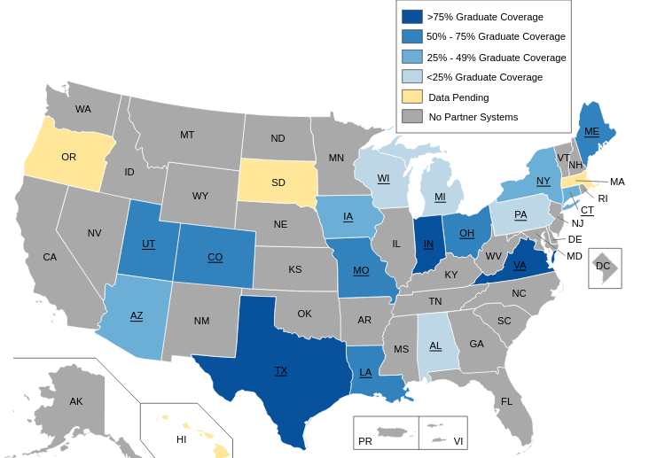
Data Coverage of PSEO dataset

Slide 5
Integrated Postsecondary Education Data System (IPEDS)
The Integrated Postsecondary Education Data System (IPEDS) is a collection of data elements collected for every postsecondary education institution in the US on a diverse range of areas including the following: Institutional characteristics, Institutional prices / tuition, Admissions, Finances, and others.
We are interested in institutional characteristics such as as tuition and fees, room and board, institutional category (public vs private), degree of rurality (urban vs fringe), size of the institution (large vs small) as predictors of student post-graduate outcomes.

Slide 6
The Question

Slide 7
With all this data, what can we do?
Can we train a machine learning model on the available data and use that to predict post-secondary employment outcomes for graduates for institutions that haven’t provided that information?

Slide 8
The Exploration

Slide 9
Finding out what each column represents
The names of many columns are vague or unclear. To find out what they stand for we referenced the LEHD Public Use Data Schema.

Slide 10
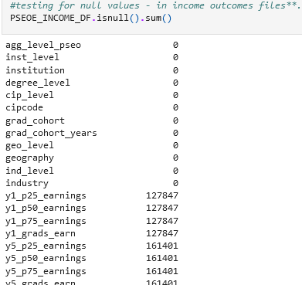
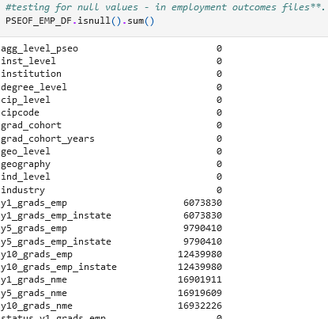
Looking for Null Values
Both the earnings and flows datasets have numerous rows that contain null values.

Slide 11
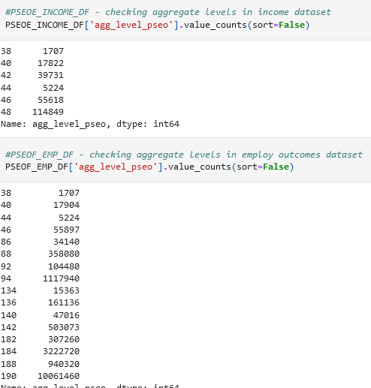
Checking Aggregation Levels
Each record is associated with an aggregation level that signifies the level of detail

Slide 12
The Analysis

Slide 13
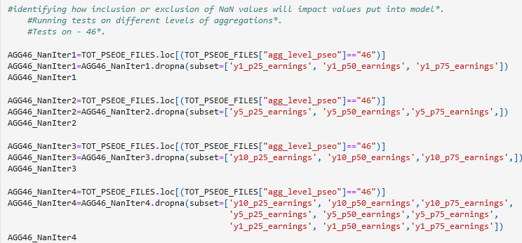
Deciding which columns to keep
We looked at how excluding records containing NaN values in the 1, 5, and 10 year outcome columns affected the data we had remaining.

Slide 14
Merging the two datasets
To keep things easier and cleaner we merged the flows and earnings datasets into one dataset.
A primary key column was created by merging column values that would uniquely identify each record.

Slide 15
The Dashboard

Slide 16
What it will look like
Search by name
Results
Filters
Cat 1
1
2
3
Cat 2
…
…
…
Cat X
Map of United States
Graphs aggregating results
Storyboard

Slide 17
Interactive Elements
Searching and selecting a specific university
Selecting state to see state outcomes and more details
Filtering outcomes and seeing matching universities

Slide 18
What we used
The dashboard is going to be created using Tableau.

